Slide 1
SB3F1 Analysis Batch 2 (GE0529)
20210827

Slide 2
General Workflow
Read Alignment by STAR
FASTQ files
FASTQ file QC
Novel Splice junction detection by Diff_Splice
transcript modeling by Kallisto

Slide 3
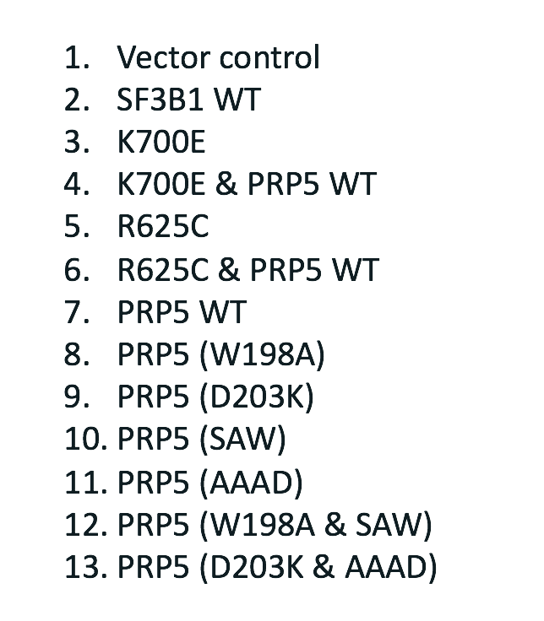
Overall Alignment and transcript quantifications are consistent across all samples with small decrease observed in K700E

Slide 4
Clustering results based on known transcript expressions
PRP5
SF3B1+PRP5
SF3B1
Vector
General observations from unbiased clustering analysis:
PRP5 overexpressed samples generally separated out from SF3B1 overexpressed samples
Vector, SF3B1 WT, SF3B1 mutants results in more consistent transcriptomic patterns compare to any samples that contains PRP5 over expression, including PRP5 WT samples.

Slide 5
Initial Differential Splice Variant Comparisons
Comparisons | Differential Splice Junctions
SF3B1 WT vs K700E | 28
SF3B1 WT vs K700E + PRP5 WT | 405
SF3B1 WT vs R625C | 53
SF3B1 WT vs R625C + PRP5 WT | 208
PRP5_WT vs AAAD | 14
PRP5_WT vs D203K | 8
PRP5_WT vs D203K + AAAD | 3
PRP5_WT vs SAW | 13
PRP5_WT vs W198A | 2
PRP5_WT vs W198A + SAW | 11
Differentially expressed junctions counts using DiffSplice built-in significant and logFC thresholds
Elevated numbers of differential jns in SF3B1 mutants combined with PRP5 WT
Small differences between SF3B1 WT vs K770E and vs. R625C, even smaller between PRP5 WT vs its mutants
More detailed examination of the data set is still needed

Slide 6
Next Steps
A potential hypothesis from this data is that elevated PRP5 WT expression results in highest level of splicing events and overwhelms any recovery that it may have on SF3B1 mutants.
Needs to perform analysis for the followings:
Double check annotation
PRP5 and SF3B1 expressions
Compare all conditions against vector as background
Compare PRP5 WT versus SF3B1 WT

Slide 7
2021-10-06 Follow up analysis

Slide 8
PRP5 transcript show extremely high expression in all PRP5 lines

Slide 9
SF3B1 transcripts expression are similar across cell lines including vector

Slide 10
PRP5_WT vs Vector
Expr | Control | Transcript | Gene | baseMean | Log2FC | Pvalue | Padj
PRP5_WT | vector | ENST00000354283 | DDX46 | 97927.82588 | 7.869667 | 7.764522e-254 | 3.214978e-249
PRP5_WT | vector | ENST00000507392 | DDX46 | 32302.70855 | 8.529686 | 2.156329e-146 | 2.976166e-142
PRP5_WT | vector | ENST00000628477 | DDX46 | 10210.46423 | 7.666471 | 1.569134e-164 | 3.248578e-160
PRP5_WT | vector | ENST00000495401 | RPL24 | 805.84485 | 2.840719 | 4.927377e-49 | 4.080459e-45
PRP5_WT | vector | ENST00000599898 | RPL18A | 746.69611 | 2.723911 | 7.641795e-30 | 1.665348e-26
PRP5_WT | vector | ENST00000521309 | YWHAZ | 729.76138 | 5.372728 | 9.264290e-14 | 7.083039e-11
PRP5_WT | vector | ENST00000577269 | EIF4A1 | 628.83055 | 1.900487 | 5.242634e-06 | 3.648344e-04
PRP5_WT | vector | ENST00000397354 | BCOR | 580.49847 | -1.243387 | 9.074480e-05 | 3.316310e-03
PRP5_WT | vector | ENST00000354171 | GPX4 | 579.58238 | 1.228732 | 1.560387e-12 | 9.099911e-10
PRP5_WT | vector | ENST00000528062 | RBM39 | 539.02901 | 1.428907 | 9.498796e-10 | 2.979600e-07
PRP5_WT | vector | ENST00000451301 | MORF4L2 | 421.83170 | 1.671825 | 1.360392e-10 | 5.029320e-08
PRP5_WT | vector | ENST00000614627 | HNRNPDL | 357.12122 | 2.410371 | 6.821320e-25 | 1.046087e-21
PRP5_WT | vector | ENST00000444061 | SMARCA4 | 339.35331 | 25.948952 | 1.913684e-12 | 1.100528e-09
PRP5_WT | vector | ENST00000545440 | SNHG1 | 329.92739 | 2.049441 | 4.559504e-36 | 1.573257e-32
PRP5_WT | vector | ENST00000555379 | LINC00641 | 312.70268 | 1.591807 | 2.126128e-07 | 2.964122e-05

Slide 11
PRP5_WT vs Vector sorted by mean expression values across all samples
Expr | Control | Transcript | Gene | baseMean | Log2FC | Pvalue | Padj
PRP5_WT | vector | ENST00000354283 | DDX46 | 97927.82588 | 7.869667 | 7.764522e-254 | 3.214978e-249
PRP5_WT | vector | ENST00000507392 | DDX46 | 32302.70855 | 8.529686 | 2.156329e-146 | 2.976166e-142
PRP5_WT | vector | ENST00000628477 | DDX46 | 10210.46423 | 7.666471 | 1.569134e-164 | 3.248578e-160
PRP5_WT | vector | ENST00000495401 | RPL24 | 805.84485 | 2.840719 | 4.927377e-49 | 4.080459e-45
PRP5_WT | vector | ENST00000599898 | RPL18A | 746.69611 | 2.723911 | 7.641795e-30 | 1.665348e-26
PRP5_WT | vector | ENST00000521309 | YWHAZ | 729.76138 | 5.372728 | 9.264290e-14 | 7.083039e-11
PRP5_WT | vector | ENST00000577269 | EIF4A1 | 628.83055 | 1.900487 | 5.242634e-06 | 3.648344e-04
PRP5_WT | vector | ENST00000397354 | BCOR | 580.49847 | -1.243387 | 9.074480e-05 | 3.316310e-03
PRP5_WT | vector | ENST00000354171 | GPX4 | 579.58238 | 1.228732 | 1.560387e-12 | 9.099911e-10
PRP5_WT | vector | ENST00000528062 | RBM39 | 539.02901 | 1.428907 | 9.498796e-10 | 2.979600e-07
PRP5_WT | vector | ENST00000451301 | MORF4L2 | 421.83170 | 1.671825 | 1.360392e-10 | 5.029320e-08
PRP5_WT | vector | ENST00000614627 | HNRNPDL | 357.12122 | 2.410371 | 6.821320e-25 | 1.046087e-21
PRP5_WT | vector | ENST00000444061 | SMARCA4 | 339.35331 | 25.948952 | 1.913684e-12 | 1.100528e-09
PRP5_WT | vector | ENST00000545440 | SNHG1 | 329.92739 | 2.049441 | 4.559504e-36 | 1.573257e-32
PRP5_WT | vector | ENST00000555379 | LINC00641 | 312.70268 | 1.591807 | 2.126128e-07 | 2.964122e-05

Slide 12
PRP5 expression remains the most significantly differential expressed genes for SF3B1 mutant+PRP5_WT when contrast against SF3B1_WT
Expr | Control | Transcript | Gene | baseMean | Log2FC | Pvalue | Padj
SF3B1_K700E_PRP5_WT | SF3B1_WT | ENST00000354283 | DDX46 | 97927.82588 | 5.924714 | 2.194148e-144 | 9.085089e-140
SF3B1_K700E_PRP5_WT | SF3B1_WT | ENST00000507392 | DDX46 | 32302.70855 | 6.487981 | 2.162785e-85 | 4.477614e-81
SF3B1_K700E_PRP5_WT | SF3B1_WT | ENST00000628477 | DDX46 | 10210.46423 | 5.308668 | 4.338457e-79 | 5.987939e-75
SF3B1_K700E_PRP5_WT | SF3B1_WT | ENST00000455528 | SON | 50.72954 | 45.674170 | 1.615419e-57 | 1.672201e-53
SF3B1_K700E_PRP5_WT | SF3B1_WT | ENST00000597959 |  | 52.90052 | 44.327660 | 2.623919e-40 | 2.172920e-36
SF3B1_K700E_PRP5_WT | SF3B1_WT | ENST00000424598 | TBL2 | 11.40870 | 44.934324 | 4.270320e-38 | 2.946948e-34
SF3B1_K700E_PRP5_WT | SF3B1_WT | ENST00000495401 | RPL24 | 805.84485 | 2.466551 | 4.470238e-36 | 2.644210e-32
SF3B1_K700E_PRP5_WT | SF3B1_WT | ENST00000422745 | ASNS | 63.83984 | 47.467782 | 6.950975e-31 | 3.597651e-27
SF3B1_K700E_PRP5_WT | SF3B1_WT | ENST00000216117 | HMOX1 | 772.28393 | 1.608841 | 1.777093e-28 | 8.175813e-25
SF3B1_K700E_PRP5_WT | SF3B1_WT | ENST00000359929 | ADGRL2 | 31.73744 | 47.589763 | 4.616125e-27 | 1.911353e-23

Slide 13
The impact of PRP5_WT overexpression is strongly present in K700E+PRP5_WT
SF3B1_K700E_PRP5_WT vs
SF3B1_WT
PRP5_WT vs SF3B1_WT
Examine DGE in both K700E+PRP5_WT vs SF3B1_WT and PRP5_WT vs SF3B1_WT shows that more than a third of the difference between K700E+PRP5_WT and SF3B1 was due to PRP5_WT alone.
231
137
118

Slide 14
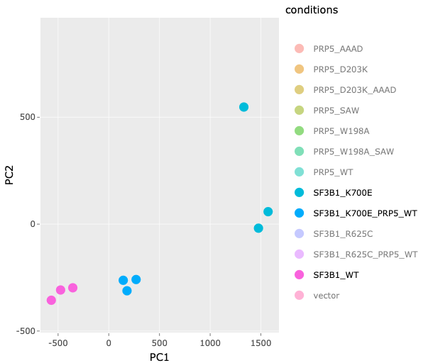
K700E_PRP5_WT model recovers some transcript dysregulation caused by K700E alone
To eliminate PRP5 overexpression effect, we only examined the 238 different expression transcripts derived from K700E vs SF3B1_WT comparisons. This ensures only K700E mutational impacts were analyzed. PCA was performed on the transcript expression to suggest transcript expression recovery by PRP5 overexpression in K700E cell lines.

Slide 15
Addition of PRP5 overexpression generally reduces transcript expressions that were increased as result of K700E mutation (n=158)
a.
b.
To examine if PRP5 overexpression with K700E mutation rescues splicing defects, we examine transcript isoforms increased as a result of K700E. A. we observed a general trend of decreasing expression when PRP5 was overexpressed with K700E. B. Closer examine of the top 20 transcript with highest Log2FC when compared K700E to SB3F1 WT. All expression were standardized for visualization. White row indicates that standardization can not be computed.

Slide 16
Addition of PRP5 overexpression generally increases transcript expressions that were decrease as result of K700E mutation (n=80)
a.
b.
Examining transcripts decreased in expression caused by K700E showed increasing expression in a few transcripts in the K700E+PRP5 cell lines. Focus on the top decreasing transcripts caused by K700E mutation again showed very limited rescue by PRP5_WT.

Slide 17
Summary
The PRP5 expression is extremely high across all PRP5 expressing cell lines
The PRP5 overexpression dominates global transcriptomic pattern
Analysis limited to only transcripts affected by K700E suggest PRP5 overexpression has some rescue effect
The PRP5 rescue effect is the strongest in reducing large isoform expression increases caused by K700E
PRP5 rescue effect is limited in reversing isoform down expression caused by K700E

